Slide 1

Project 245
Customer Personality Analysis

Slide 2
Group members
Pratik Taori
Pratik Tarale
Gaurav Deshmukh
Himanshu Patil
Gurjeet Punjabi
Umang Mantri

Slide 3
Problem Statement
Customer Personality Analysis is a detailed analysis of a company’s ideal customers. It helps a business to better understand its customers and makes it easier for them to modify products according to the specific needs, behaviours and concerns of different types of customers.
Customer personality analysis helps a business to modify its product based on its target customers from different types of customer segments. For example, instead of spending money to market a new product to every customer in the company’s database, a company can analyse which customer segment is most likely to buy the product and then market the product only on that particular segment.

Slide 4
objective
The Main Aim of project is to need perform Clustering to summarize customer segmentation

Slide 5


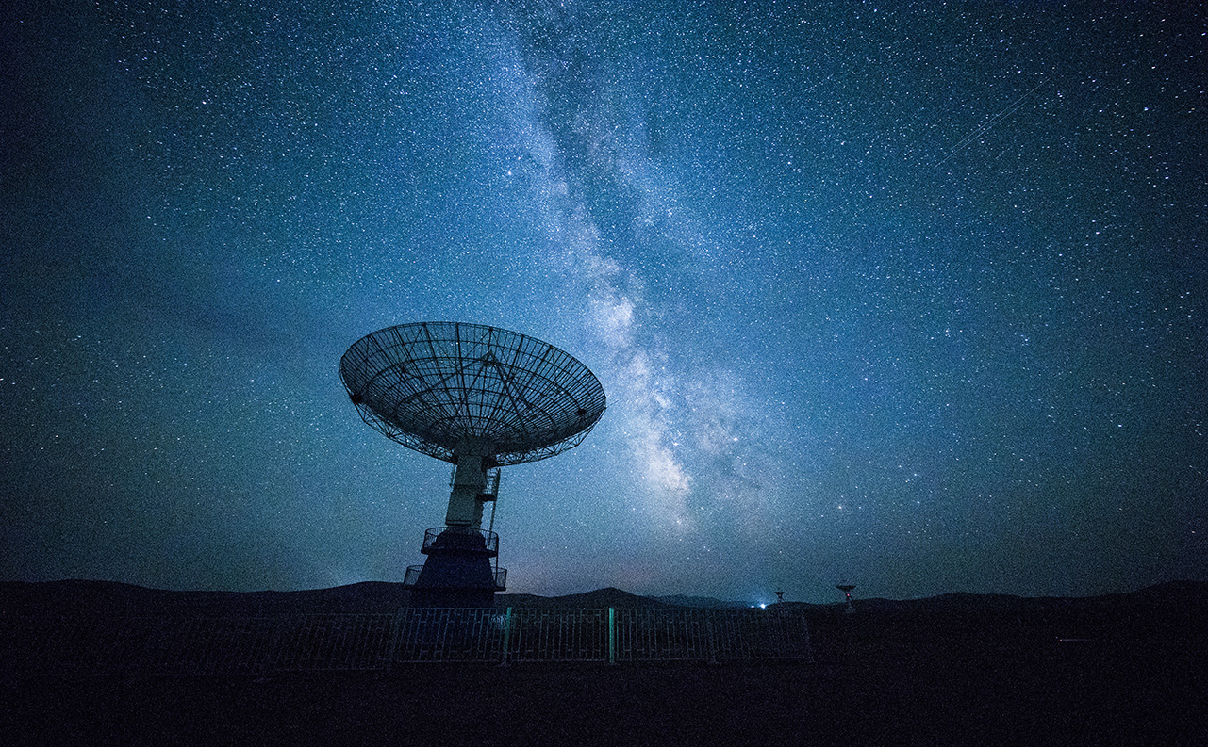
Project flow
Data Collection
EDA
Feature Engineering
Model Building And Evaluation
Model Deployment

Slide 6
Data Collection

Slide 7
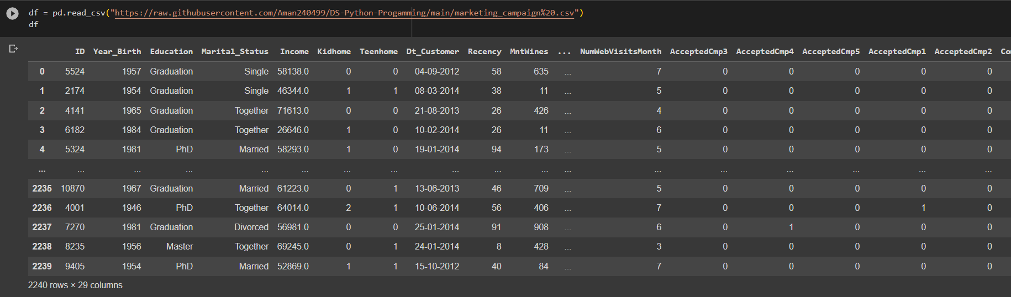
Load data in Python notebook by creating variable as df.

Slide 8
Exploratory Data Analysis
{EDA}

Slide 9
EDA
In EDA is a step to ensure the data is cleaned and ready for processing, providing insights and preventing errors

Slide 10
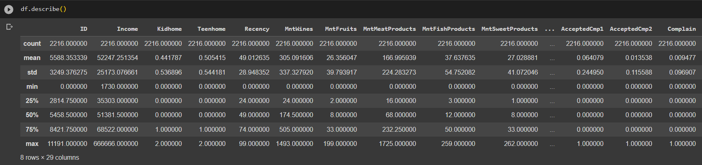
Basic description of the data set

Slide 11
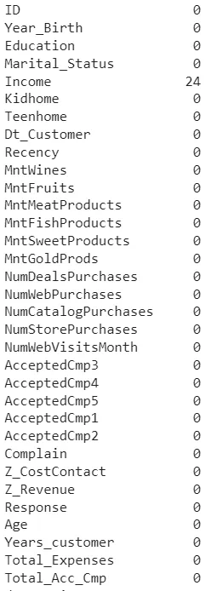
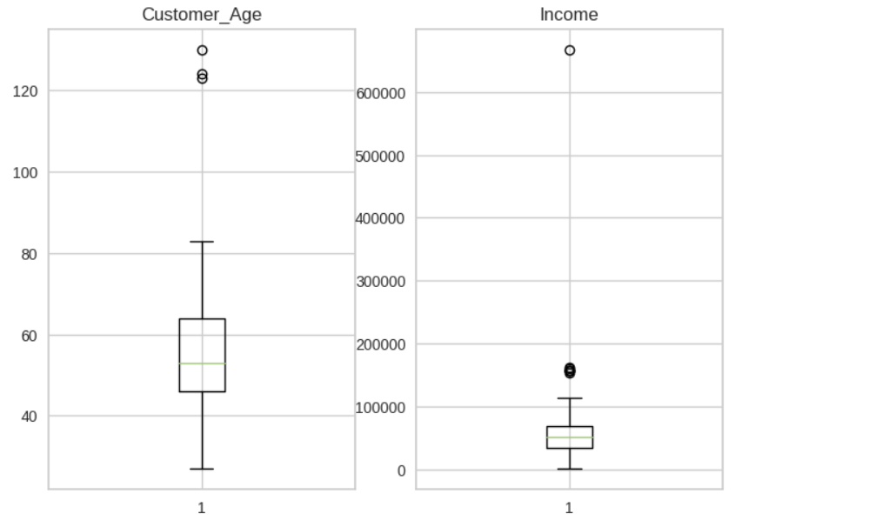
From boxplot we checking the outlier and null value
Checking a null Value

Slide 12
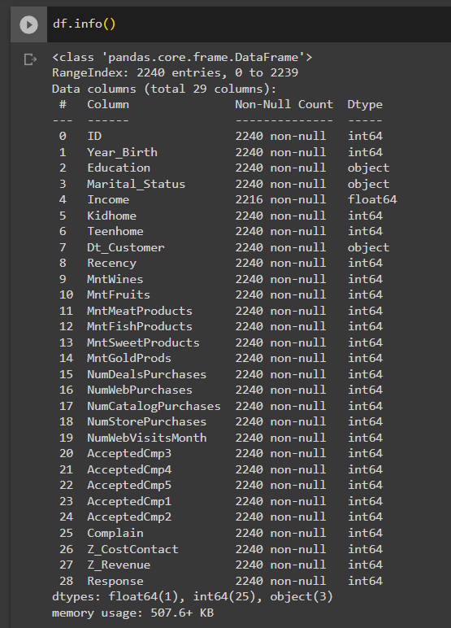
Checking a data types

Slide 13
Feature Engineering

Slide 14
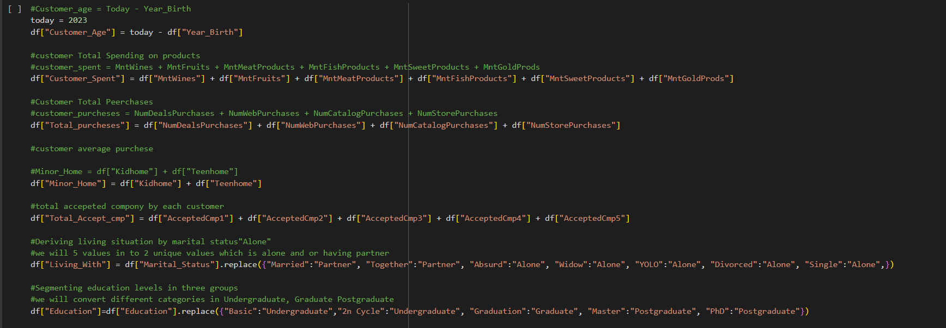

Slide 15
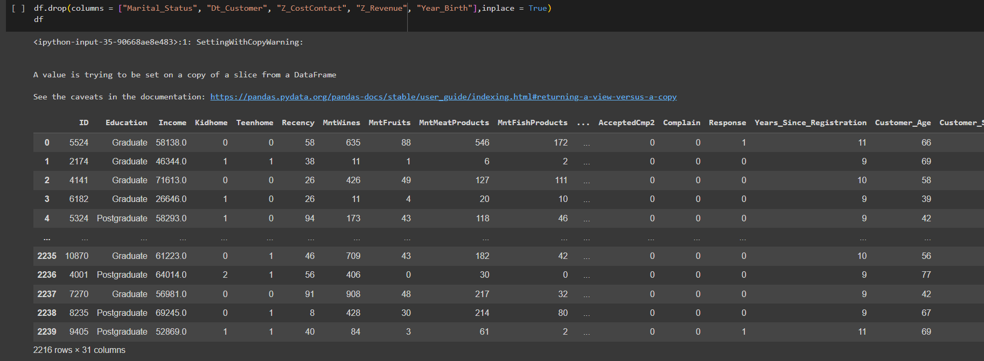
Drop a unnecessary Feature & drop a columns

Slide 16
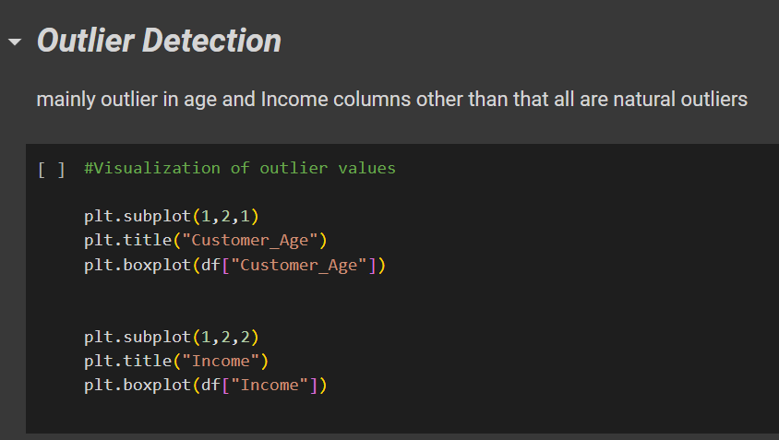

Slide 17
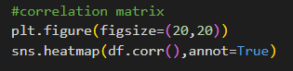
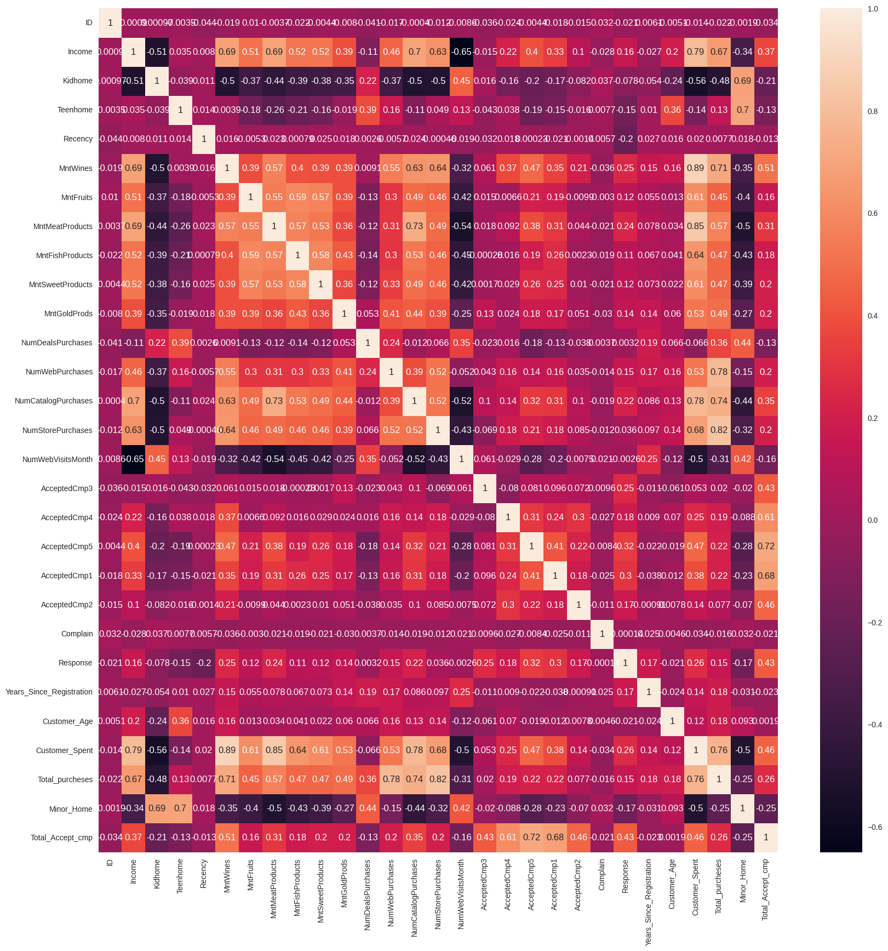

Slide 18
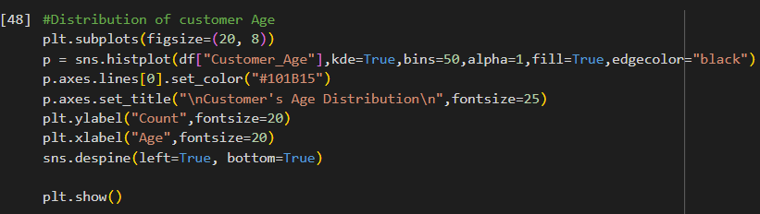
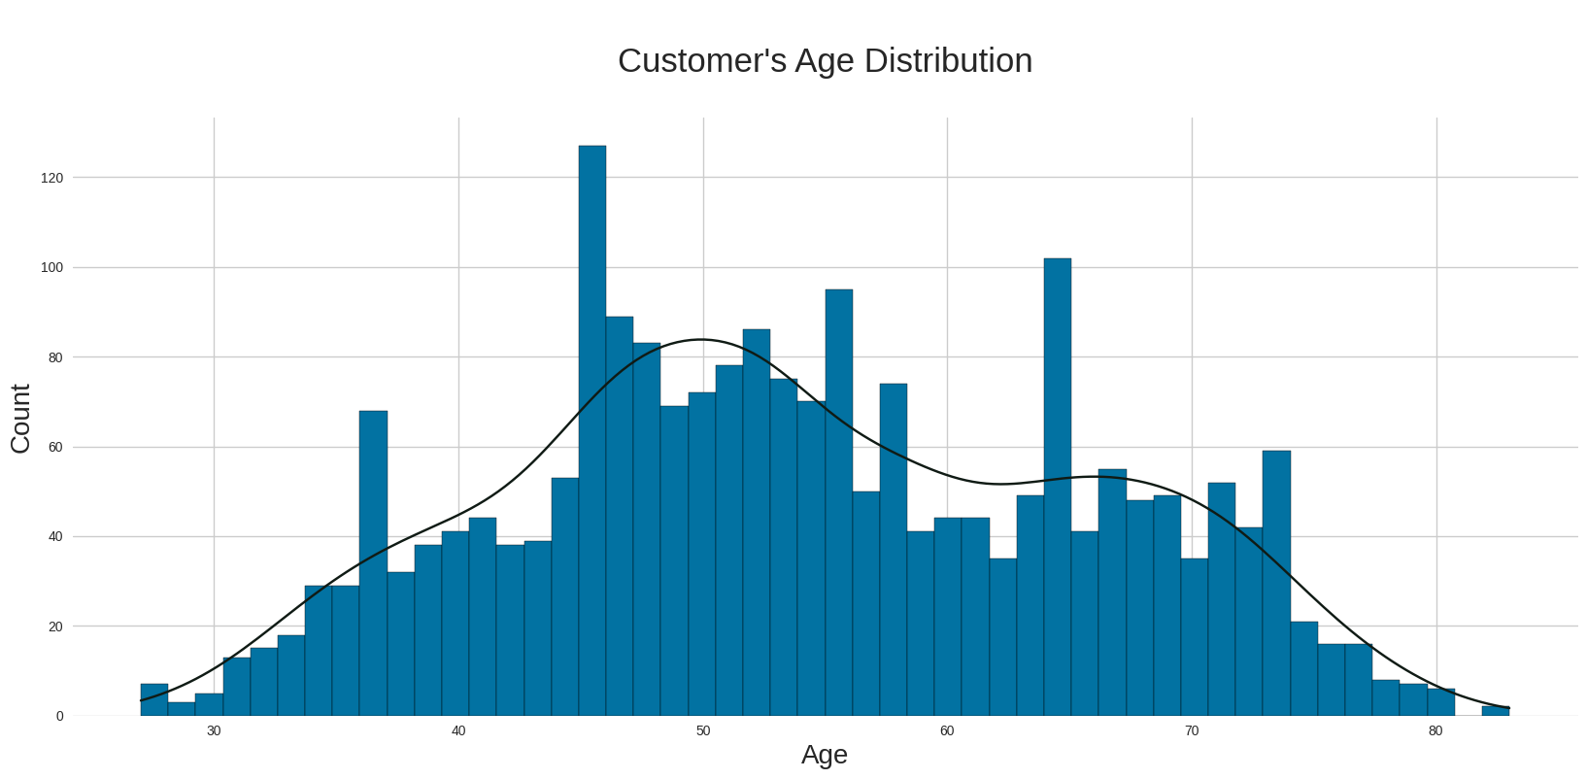

Slide 19
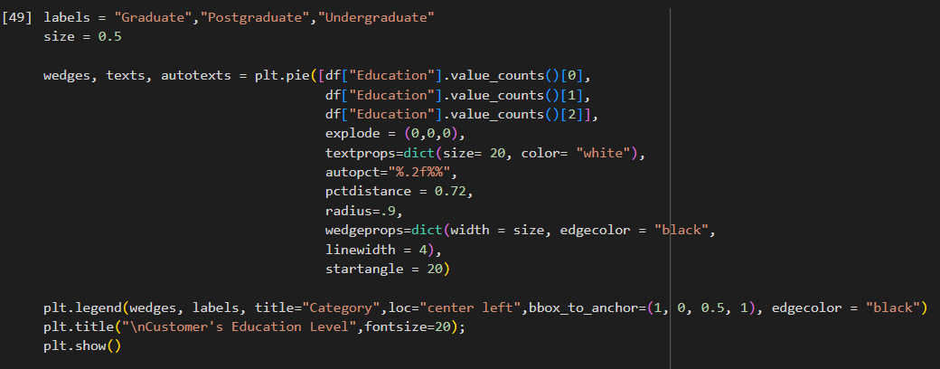
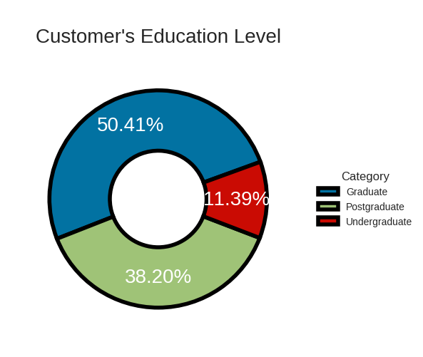

Slide 20
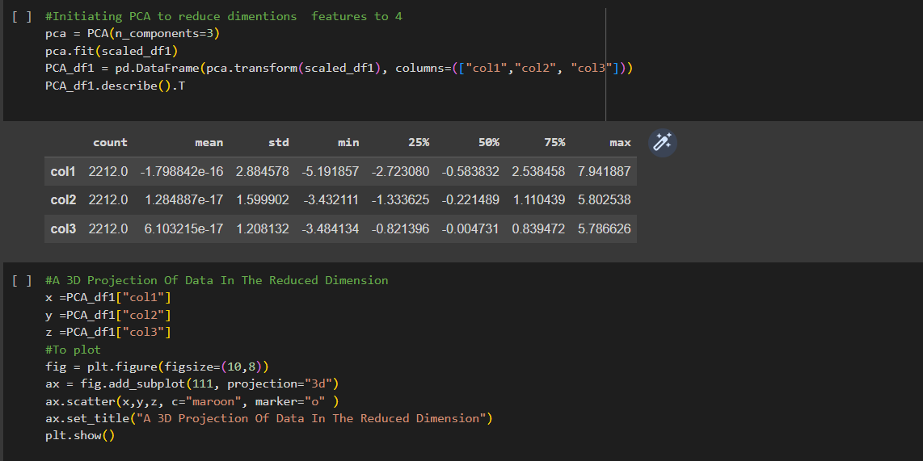
Dimensionality Reduction
Dimensionality Reduction using PCA

Slide 21
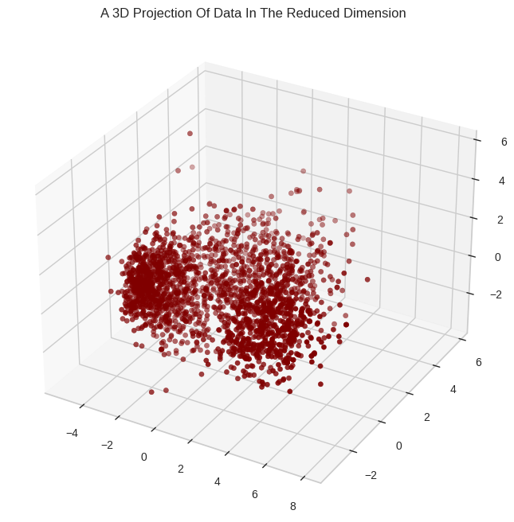

Slide 22
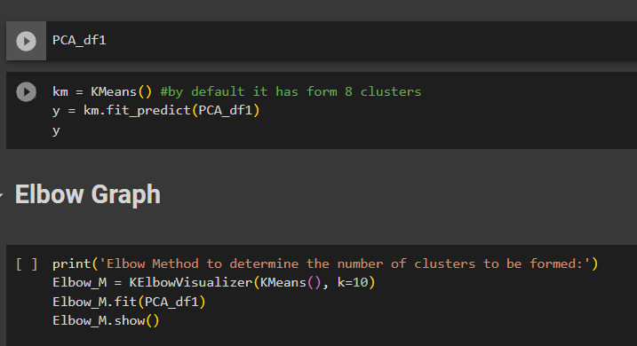
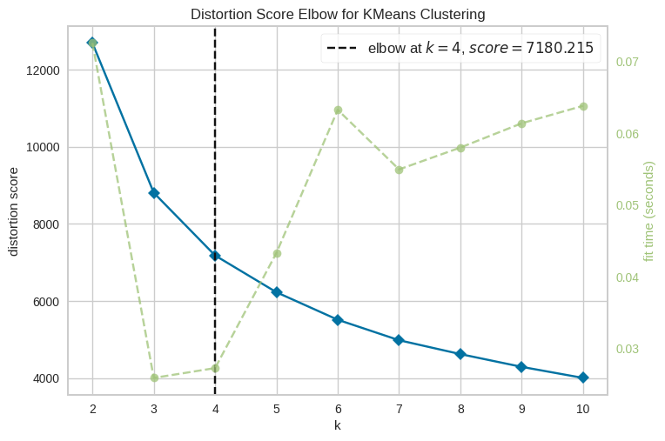
Clustering
In a given data we want to find a cluster by KMeans
In This way we got a 4 cluster
By KMeans method
Cluster 3 highest spent and highest earning Cluster 2 lowest spent low income Cluster 0 high income low spend Cluster 1 high income high spending

Slide 23
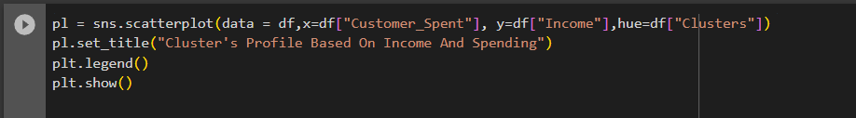
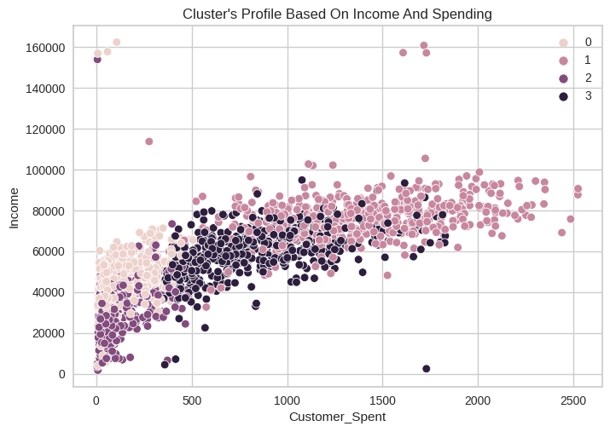

Slide 24
Model Building
and Evaluation

Slide 25
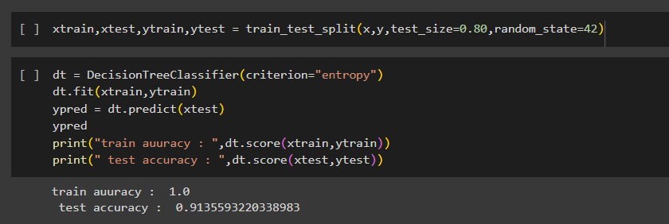
There Are 3 Types of models
1.Overfitted --> If training accuracy is very high and testing accuracy is very low (more than 3% of difference) it is overfitted model
2.Underfitted -->model is not able to perform good in training as well as testing it is an underfitted model
3.Generalized -->both training accuracy and testing accuracy is high (less than 3 difference between training and testing accuracy)
Decision Tree Using train_test_split(model validation technique)
This is overfitted model.

Slide 26
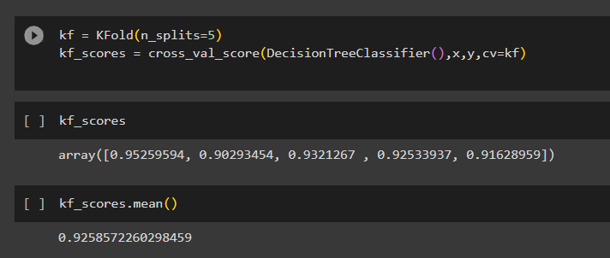
Decision Tree Using KFold(model validation technique)
This is overfitted model

Slide 27
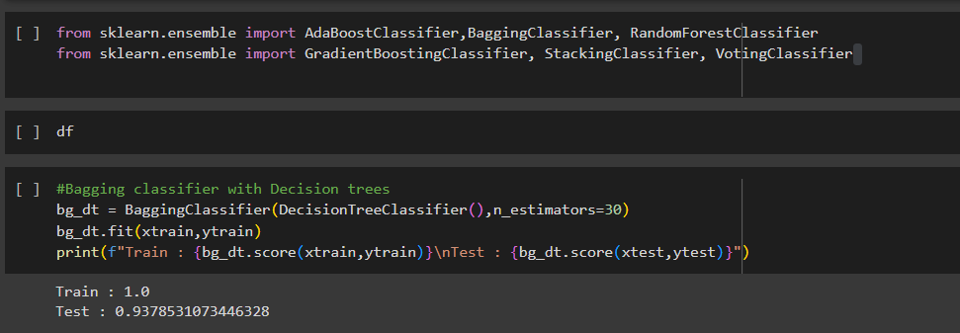
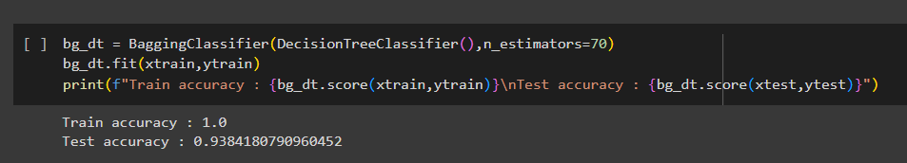
*Ensemble Technique *
1. Bagging
2. Boosting
3.Stacking
1. Bagging(DecisionTreeClassifier)
This is overfitted model

Slide 28
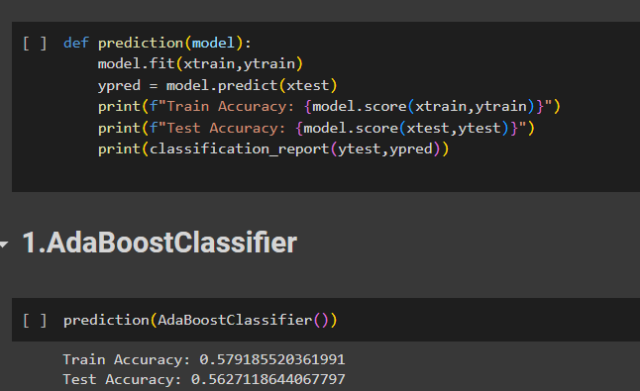
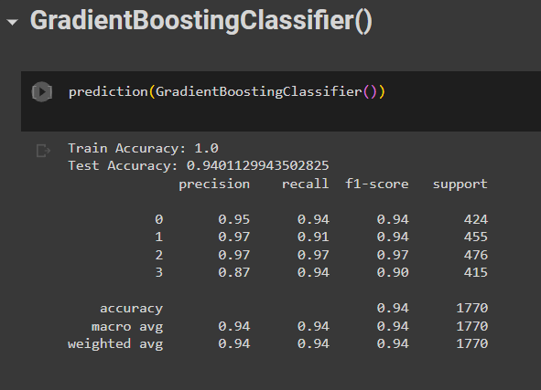
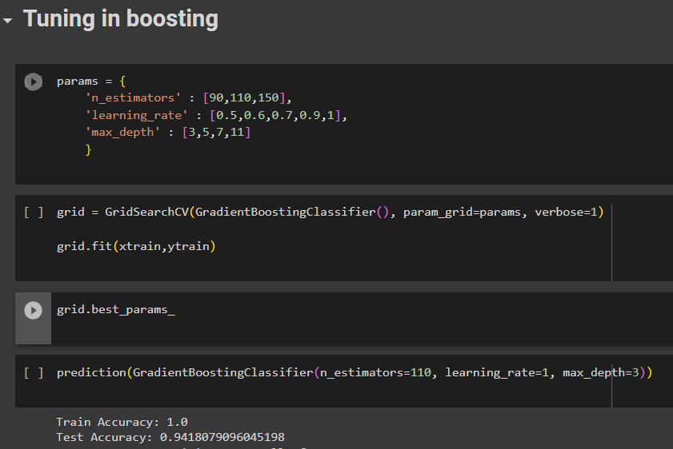
2. Boosting
This is underfitted model.
This is overfitted model.
This is overfitted model.

Slide 29
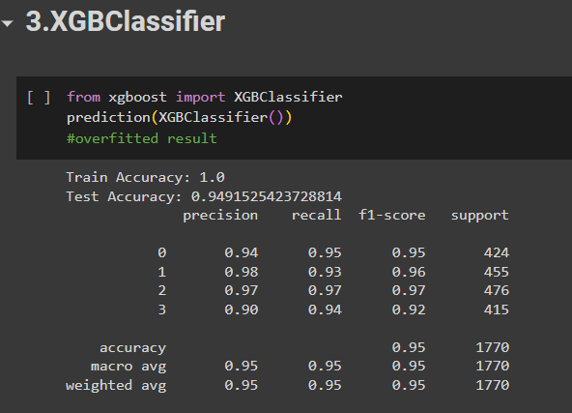
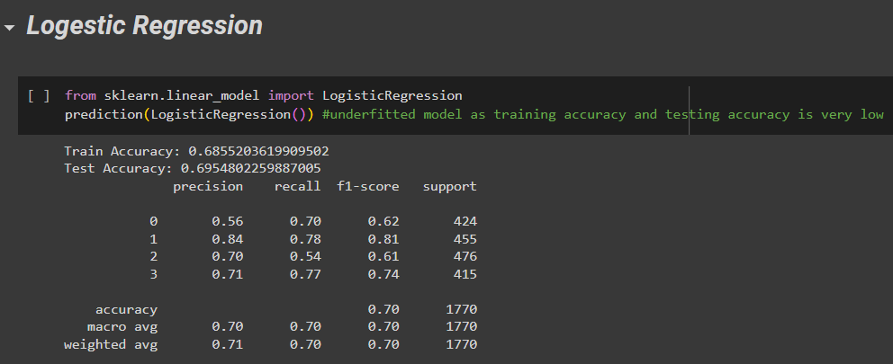
This is overfitted model.
This is underfitted model.

Slide 30
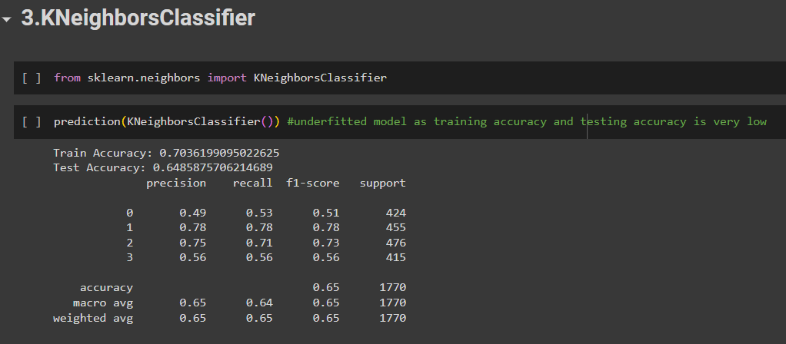
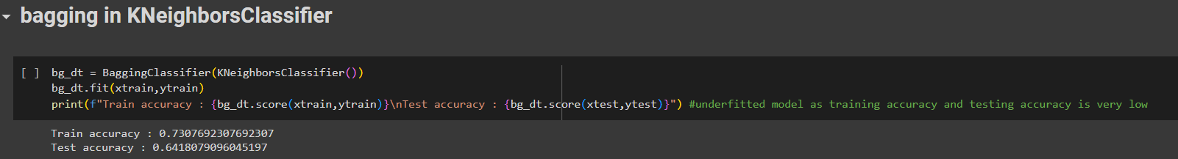
This is underfitted model.
This is underfitted model.

Slide 31
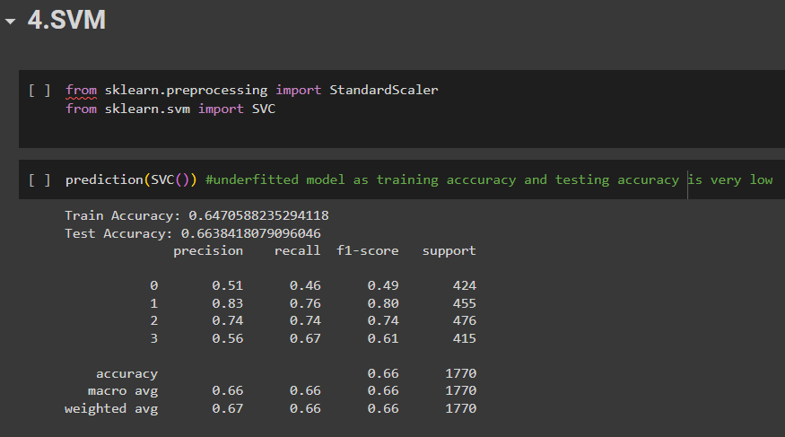
This is underfitted model.

Slide 32
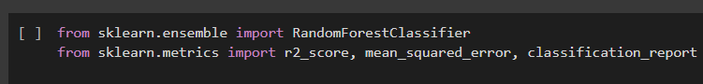
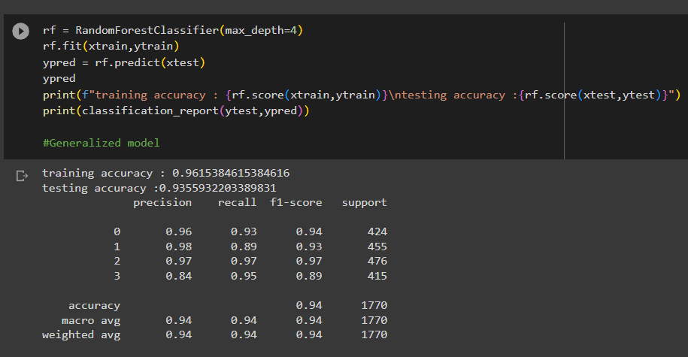
Random Forest
This is Generalized model.
Random forest is a best performing algorithm so we will use random forest algorithm.
Random Forest is our final model.

Slide 33
Model Deployment

Slide 34
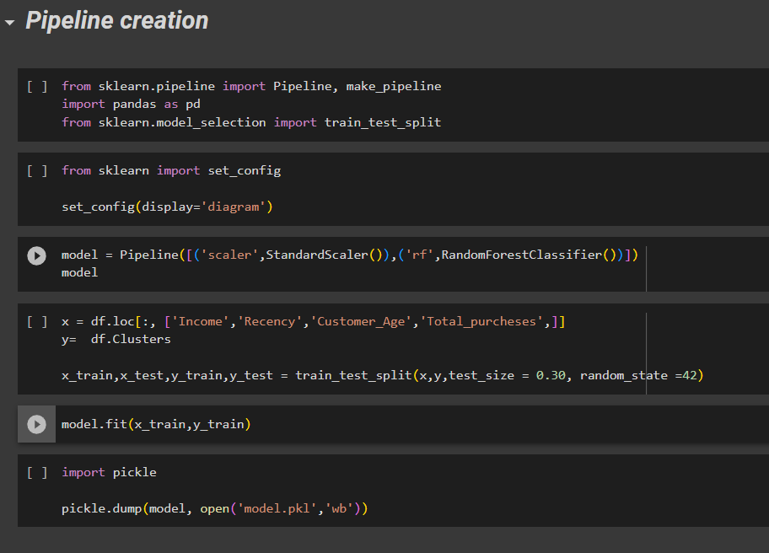
We create pipeline for deployment of our model.
We select 'Income','Recency','Customer_Age','Total_purcheses ‘ columns for input purpose
and cluster column for output purpose

Slide 35
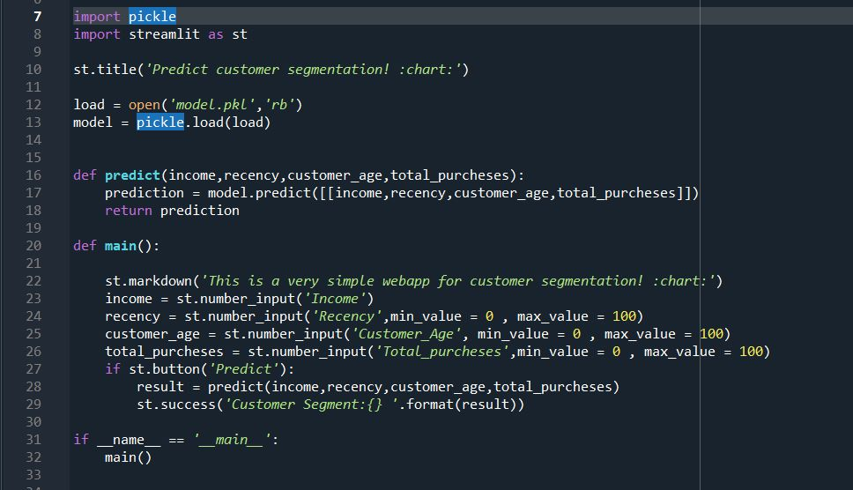
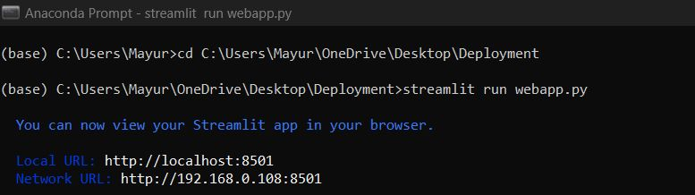
We use deployment in Streamlit

Slide 36
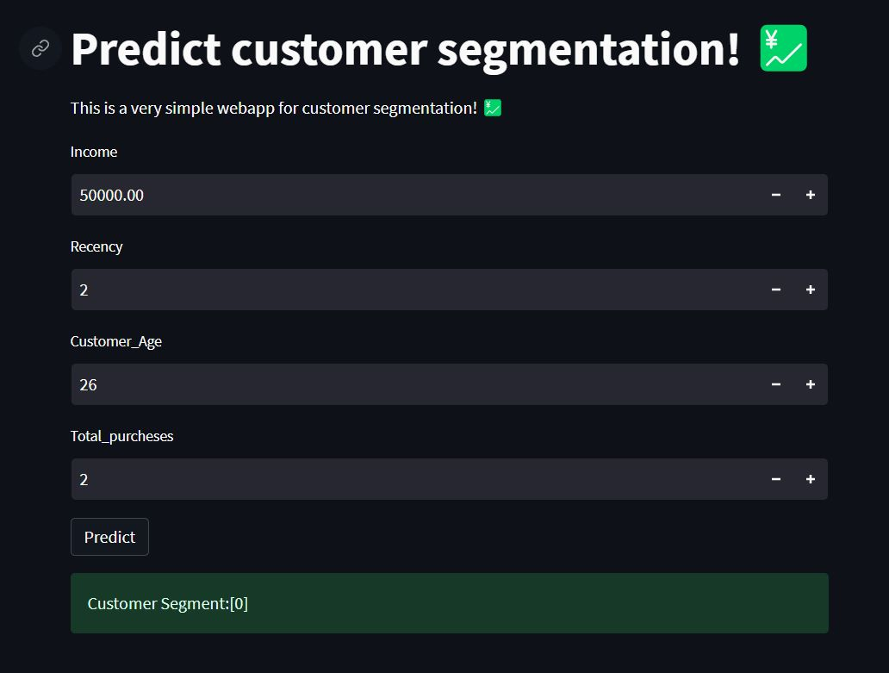
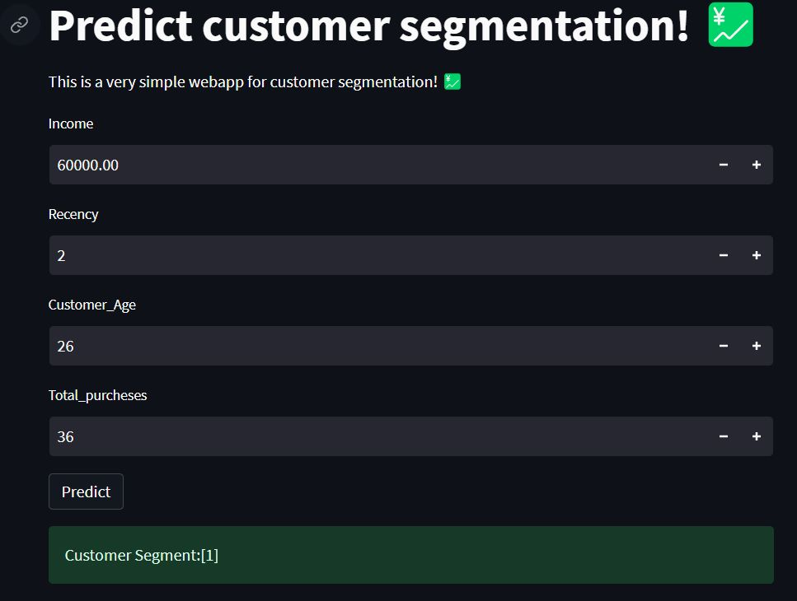
High income low spending
High income High spending

Slide 37
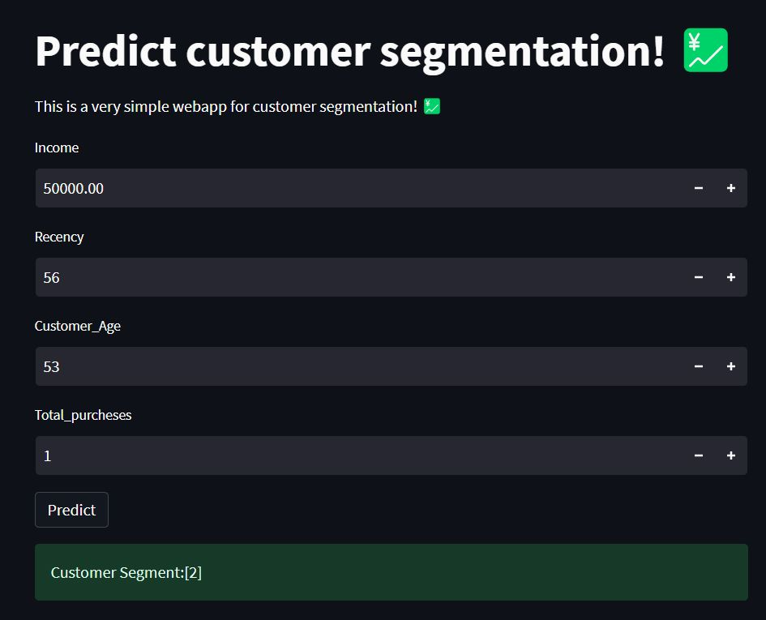
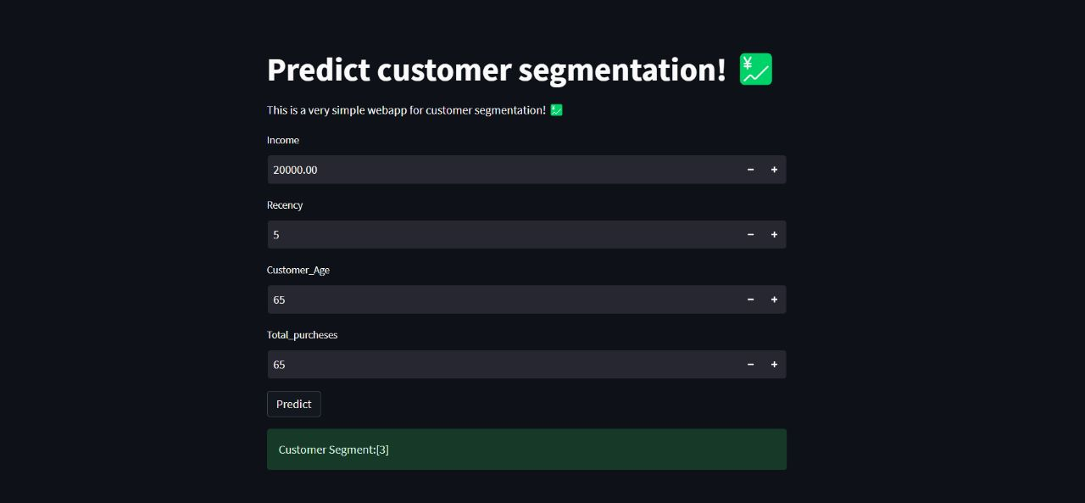
Lowest Income low Income
Highest spend And high earning

Slide 38

Thank You!

